Slide 1


COMPANY PROFILE
DIGIPRO SOLUTIONS LTD.
WWW.DIGIPROBD.COM

Slide 2

ABOUT US
DigiPro Outsourcing Limited is a premier Business Process Outsourcing (BPO) provider specializing in:
Finance & Accounting (F&A)
Regulatory Reporting (Tax and VAT)
SOX/ICFR Testing Support
Robotic Process Mining & Automation
We are proud partners to some of Bangladesh’s largest enterprises.
With a talented pool of 50+ professionals under the guidance of qualified accountants, we ensure superior service delivery.
Fellow Chartered Accountants: 2
ACCA Members: 1
CISA Certified: 1
AFA/MIPA Qualified: 1
Part-qualified CAs: 10
BBA/MBA Graduates: 35
CEO OF TIMMERMAN INDUSTRIES

Slide 3

OUR SERVICES
DigiPro team comprises seasoned professionals with extensive expertise in finance, accounting, information systems, and management. We bring a holistic and multifaceted approach to problem-solving, backed by years of hands-on experience.
1
2
3
4
Professional Services
Manpower Supply
Information Technology
Efficiency & Effectiveness Review
Finance & Accounts
TAX
Internal Audit
Payroll
Sourcing
Import & Export Operations
Finance & Accounts
TAX
Internal Audit
Payroll
Sourcing
Contact Center
HR
Import & Export Operation
Software Development
Maintenance
IT Operations
IT Service Desk
Structured Processes Inventory.
Cost Reduction
Operational and Control Work Identifications
Process Simplification and Automation

Slide 4
Finance & Accounts Services
1
2
3
Procure to Pay
Order to Cash
Record to Report
1
Utility bill receiving to payment
Lease schedule Mgt and payment
Vendor Invoice (Local and Foreign) receiving to pay.
Employee Travel and Expense settlement
Bank Reconciliations (Host to host + manual
Inter Company Reconciliations
Institutional Collection system record
Interconnection Receivable Invoicing
Invoicing of Non-Mobile Revenue (Site share, FON, MFS)
Commission Payment
Interconnection Cost Payment
Inbound Roaming Invoicing
Fixed Asset recording Mgt end to end
Provision Control and
Reversal journals
Reconciliation (HFM vs Fusion)
Reconciliation (HFM vs. statutory)
Module Close
Audit Deliverables
Financial statements Preparation, Variance analysis and control
EFFICIENCY & COST-EFFECTIVENESS
Optimized service delivery tailored to client needs.
Scalable resource management to meet dynamic business demands.

Slide 5
WHY CHOOSE DIGIPRO?
1
2
3
4
EFFICIENCY & COST-EFFECTIVENESS
DATA SECURITY AND COMPLIANCE
GLOBAL REACH, LOCAL EXPERTISE
CONSISTENT QUALITY
Optimized service delivery tailored to client needs.
Scalable resource management to meet dynamic business demands.
AI-based restrictions on data sharing and copying.
Robust policies on workplace privacy, laptop use, and credentials management.
Quarterly workshops on compliance and corporate governance.
Expertise in North America-centric financial services, offering significant cost advantages.
Structured processes and a well-trained backup workforce ensure uninterrupted delivery.

Slide 6




OUR CLIENTS
We proudly serve leaders in their industries, including:

Slide 7








SYSTEM SKILLS
All customized software that are being used by our present clients, including the below:

Slide 8
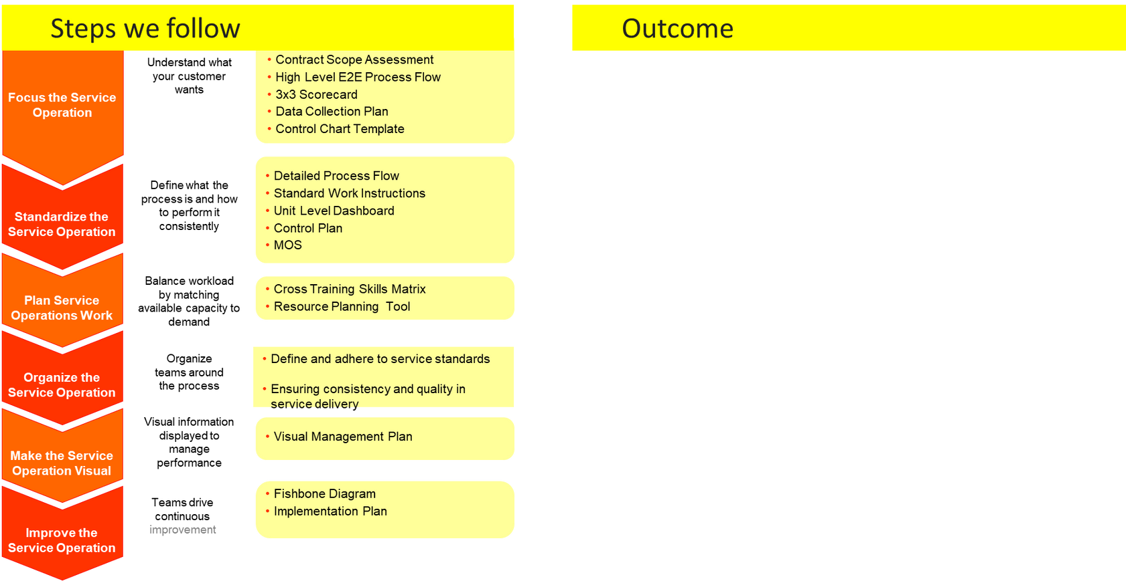
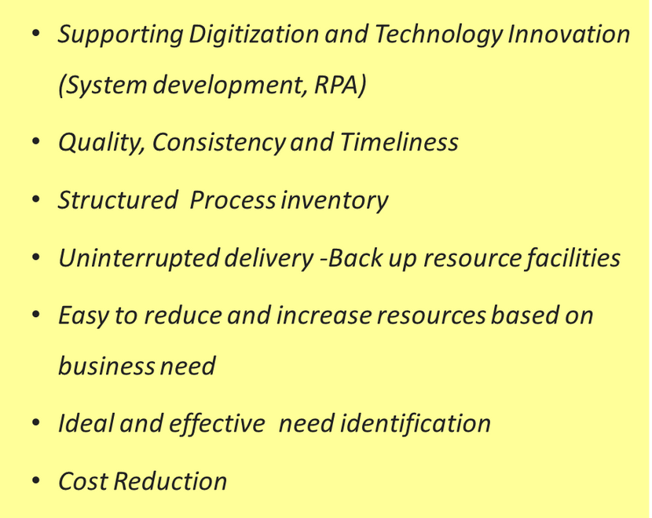
EFFICIENCY & COST EFFECTIVENESS WAY FORWARD

Slide 9

DATA SECURITY & COMPLIANCE GOAL
CoC Guidelines of the Company and Client(s).
NDA signing with the respective employees.
Privacy, Security, Data, Information, Laptop Use etc. Policies.
Workplace Policy and Decorum.
Strict governance with quarterly CoC and Compliance workshop for ALL the Employees.
1
STRICTLY PROHIBITED & MONITORED
Data copy and sharing: AI based restriction. No data copy and sharing without proper authorization.
Password & credentials: Never share your password & credentials with ANYONE.
Laptop sharing: You are not permitted to share your laptop with ANYONE.
Pen-drive use: Don’t use personal / outside Pen-drive in your office Laptop.
Personal work: Don’t do any personal work in the office laptop.
Other client’s work on office laptop: Don’t do other client’s work on office laptop.

Slide 10
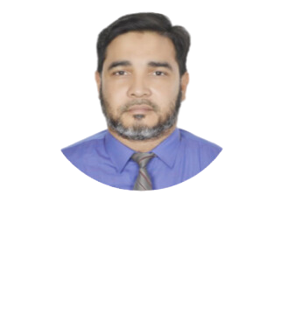
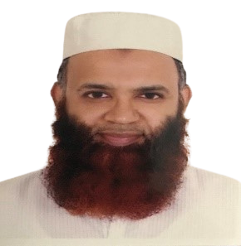
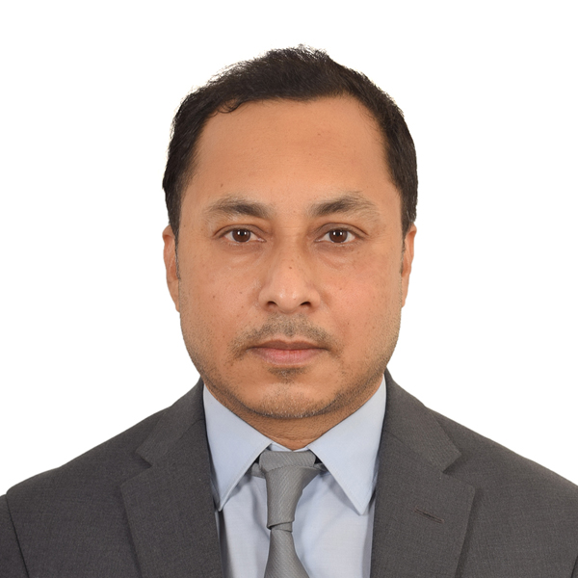
FOUNDERS PORTFOLIO
Md. Soebul Islam, MBA,CA (Inter)AFA
Ruhul Amin,
Mohammad Saif Uddin, FCA
Managing Director
Director HR
Chairman
20 years of experience in Telco, outsourcing and various MNC’s, Health sector and Financial institution consultancies. Proven Outsourcing leadership exposer in local and global perspective.
Core expertise in F&A operations, Transformation & Change Management, (at local and global level), Project Management, Process simplification.
16 Years work experience with Grameenphone and Telenor Business Units and accustomed with the work process, culture and leadership practice.
Worked for GP, Telenor Servia, Telenor Montenegro, Accenture, Unilever, Youngone group, Asian Development Bank consultancies
Trained onsite in London Business School-UK, Telenor Head Quarter Oslo.
Professional educational – MBA major in Accounting, CU, Chartered Accountancy (Inter) KPMG Bangladesh, Associate of Financial Accountant (UK)
An entrepreneur with 23 years of Management experience in Customer Service, HR/OD and Management Consulting.
19 years work experience with Grameenphone and Telenor, Oslo and accustomed with the work process, culture and leadership practice.
Worked in GP from Dec 1997–Dec 2012 and Telenor HQ 2013– 2017.
Co-Founder Agilex HR Solutions, ProNET (BD), Udoy International (Malaysia), Buy Sale Buy (US).
Training & Certifications in Lean 6-Sigma Green Belt, Program Management, Telenor Core Leadership Program, Workday HRIS, HR Analytics
Core expertise in People & OD, Transformation & Change Management (at local and global level), Project/PMO, Collaboration, Business Process, Policy, Reporting, and CRM/HRIS/ERP systems
More than 20 years of professional experience across KPMG in Bangladesh and Malaysia
Lead the Audit, Tax and Advisory functions of KPMG, Chittagong Office for more than 8 years.
Core expertise includes Audit, Direct & Indirect Tax, Transaction Service, Valuation Service, Process Development, Information Systems Audit etc.
Managed outsourced full backoffice operation of several foreign Subsidiaries
Major Clients include BATBC, Unilever, James Finlay, KAFCO, Youngone Group etc.
Professional Qualification-FCA(ICAB), ACA(England & Wales), Certified Information Systems Auditor, USA.

Slide 11






CONTACT US
Dhaka Office: Haveily Complex, KA-6, (2nd Elevator, Level-6C), Bashundhara Road, Jagannathpur,Dhaka-1229, Bangladesh.
Chattagram Office: Delowar Bhaban (3rd Floor), 104 Agrabad Commercial Area, Chattogram 4100, Bangladesh.
(880) 17 11506306- Soeb
(880) 18 19380455- Saif
www.digiprobd.com
soeb@digiprobd.com
Saif@digiprobd.com

Slide 12

THANK YOU
FOR YOUR ATTENTION

